Slide 1



Machine Learning with

Slide 2

What are ensembles:
Ensemble learning helps improve machine learning results by combining several models. This approach allows the production of better predictive performance compared to a single model. That is why ensemble methods placed first in many prestigious machine learning competitions, such as the Netflix Competition, KDD 2009, and Kaggle.
Ensemble methods are meta-algorithms that combine several machine learning techniques into one predictive model in order to decrease variance (bagging), bias (boosting), or improve predictions (stacking).
Most ensemble methods use a single base learning algorithm to produce homogeneous base learners, i.e. learners of the same type, leading to homogeneous ensembles.

Slide 3
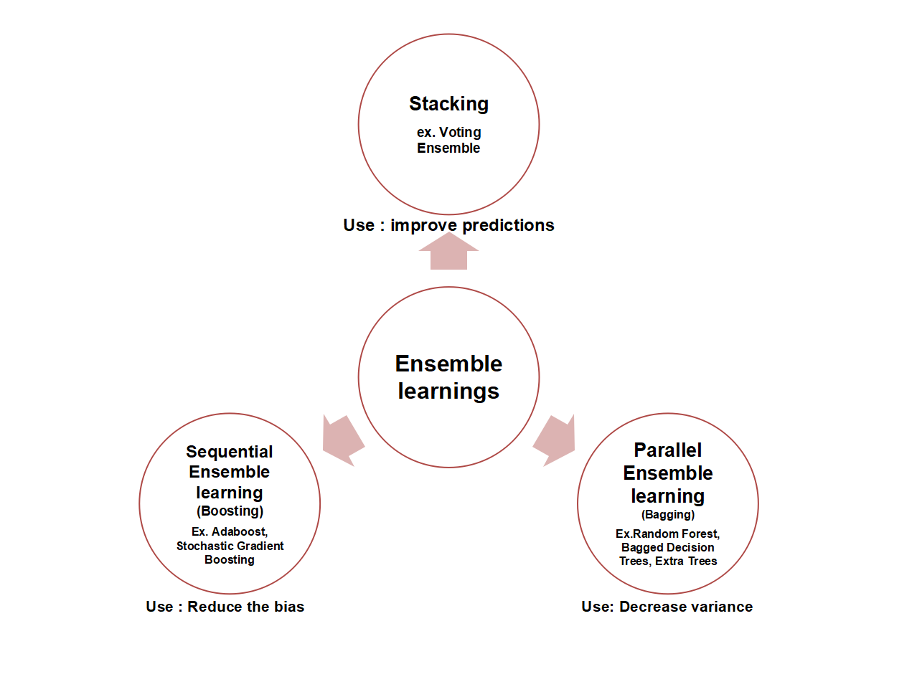
ensembles

Slide 4
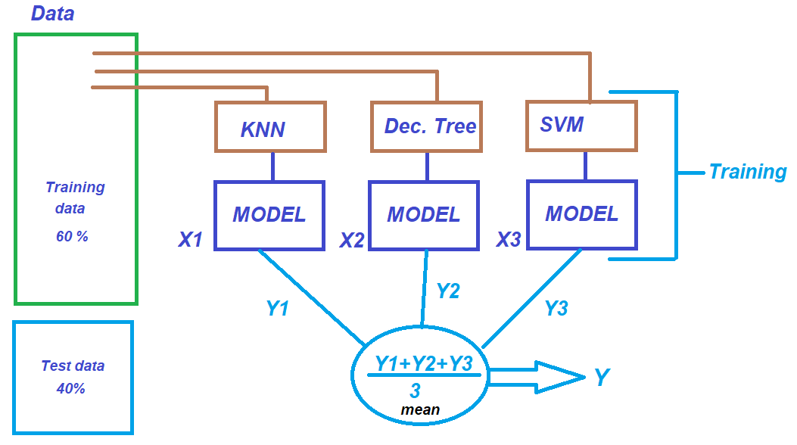
ensembles:

Slide 5
Bootstrapped Aggregation (Bagging) Intuition
The first ensemble technique that I will discuss is Bagging. Bagging stands for bootstrap aggregation. Bagging is one of the earliest, interesting and a very powerful ensemble algorithm. The core idea of bagging is to use bootstrapped replicas of the original dataset and use them to train different classifiers.
We will create subsets by randomly sampling a bunch of points from the training dataset, with replacement. Now we will train individual classifiers on each of these bootstrapped subsets. Each of these base classifiers will predict the class label for a given problem. This is where we combine the predictions of all the base models. This part is called the aggregation stage.

Slide 6
Bootstrapped Aggregation (Bagging) Intuition
Typically a simple majority vote is used in a classification system and taking the mean of all predictions for regression models, to combine all the base classifiers into one single model to provide the final output of the ensemble model. A simple example of such an approach is the Random Forest algorithm. Bagging reduces the high variance of a model, thereby reducing the generalization error. Bagging is a very efficient method especially when you have very limited data. By using bootstrapped samples we are able to get an estimate by aggregating the scores over many samples
Please take a look at the below diagrams to get an intuitive understanding of how bagging works at different stages.

Slide 7
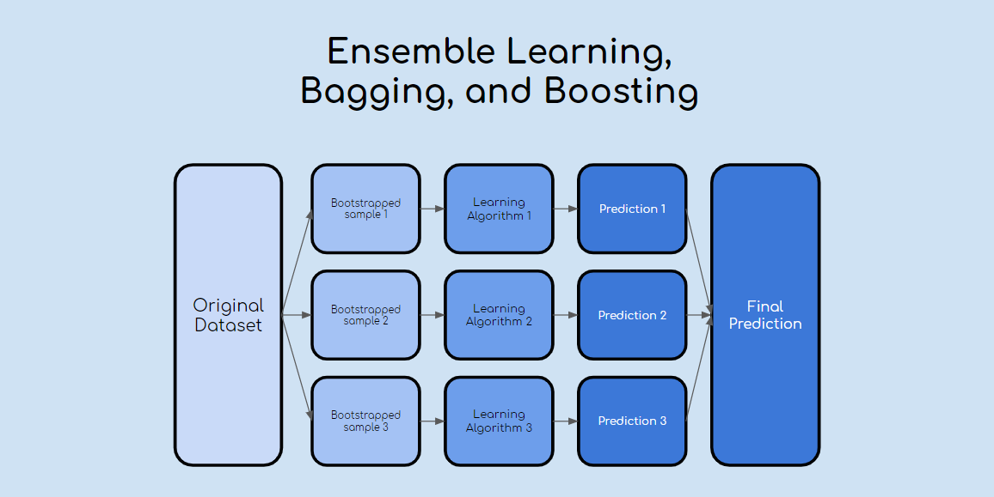
Bootstrapped Aggregation (Bagging) Intuition

Slide 8
Random Forest
First, Random Forest algorithm is a supervised classification algorithm. We can see it from its name, which is to create a forest by some way and make it random. There is a direct relationship between the number of trees in the forest and the results it can get: the larger the number of trees, the more accurate the result. But one thing to note is that creating the forest is not the same as constructing the decision with information gain or gain index approach.
The author gives 4 links to help people who are working with decision trees for the first time to learn it, and understand it well. The decision tree is a decision support tool. It uses a tree-like graph to show the possible consequences.
If you input a training dataset with targets and features into the decision tree, it will formulate some set of rules. These rules can be used to perform predictions
The difference between Random Forest algorithm and the decision tree algorithm is that in Random Forest, the process es of finding the root node and splitting the feature nodes will run randomly.

Slide 9
Make predictions and check accuracy.
#prediction y_pred = classifier.predict(X_test) #Accuracy from sklearn import metrics print('Accuracy Score:', metrics.accuracy_score(y_test,y_pred))
The decision tree classifier gave an accuracy of 91%.
Confusion Matrix
from sklearn.metrics import confusion_matrix cm = confusion_matrix(y_test, y_pred) Output: array([[64, 4],[2,30]])

Slide 10
Decision Tree as Classifier
It means 6 observations have been classified as false.
Let us first visualize the model prediction results.
from matplotlib.colors import ListedColormap X_set, y_set = X_test, y_test X1, X2 = np.meshgrid(np.arange(start = X_set[:,0].min()-1, stop= X_set[:,0].max()+1, step = 0.01),np.arange(start = X_set[:,1].min()-1, stop= X_set[:,1].max()+1, step = 0.01)) plt.contourf(X1,X2, classifier.predict(np.array([X1.ravel(), X2.ravel()]).T).reshape(X1.shape), alpha=0.75, cmap = ListedColormap(("red","green"))) plt.xlim(X1.min(), X1.max()) plt.ylim(X2.min(), X2.max()) for i,j in enumerate(np.unique(y_set)): plt.scatter(X_set[y_set==j,0],X_set[y_set==j,1], c = ListedColormap(("red","green"))(i),label = j) plt.title("Decision Tree(Test set)")

Slide 11
Decision Tree as Classifier
Let us also visualize the tree
conda install python-graphviz pip install pydotplus
export_graphviz function converts decision tree classifier into dot file and pydotplus converts this dot file to png or displayable form on Jupyter.
from sklearn.tree import export_graphviz from sklearn.externals.six import StringIO from IPython.display import Image import pydotplus dot_data = StringIO() export_graphviz(classifier, out_file=dot_data, filled=True, rounded=True, ,

Slide 12
Random Forest
Random forest is a supervised learning algorithm which is used for both classification as well as regression. But however, it is mainly used for classification problems.
Random forest algorithm creates decision trees on data samples and then gets the prediction from each of them and finally selects the best solution by means of voting.

Slide 13
Extremely randomized trees:
Extremely randomized trees pick a node split very extremely (both a variable index and variable splitting value are chosen randomly)
Random Forest finds the best split (optimal one by variable index and variable splitting value) among random subset of variables.
In the extreme case, it builds totally randomized trees whose structures are independent of the output values of the learning sample.
The strength of the randomization can be tuned to problem specifics by the appropriate choice of a parameter.
We evaluate the robustness of the default choice of this parameter, and we also provide insight on how to adjust it in particular situations

Slide 14
Random Tree Cases:
random forest builds multiple decision trees and merges them together to get a more accurate and stable prediction
Random forest has nearly the same hyperparameters as a decision tree or a bagging classifier

Slide 15
Thank you

